Slide 1
Optical Box for Optical Computing
Optical Box operated under control of embedded computer for Optical Computing like Fourier Transform by a Lens or 2D Fourier Transform. Calculation price (or energy power per single math operation) of Optical Box is 5-10% or less of Discrete Processor calculation price. Optical Computing is not a universal panacea of Computing Industry. It has many limitations, need special knowledge, and need additional research in math, optics and algorithms.

Slide 2
History
Optical Computing is not a modern idea or technology. Optical Computing idea was popular during 1980-1990. There are many publications and research exists, but until now, no one device sold for public.
Major technics used for Optical Computing is Fourier Transform by a Lens or 2D Fourier Transform.
During previous century electronic components was expensive, other components was unique and do not provide required quality to make product for everyone. Therefore, computing technology has been concentrated to manufactory Discrete Processors based on logic of switchers and transistors.

Slide 3
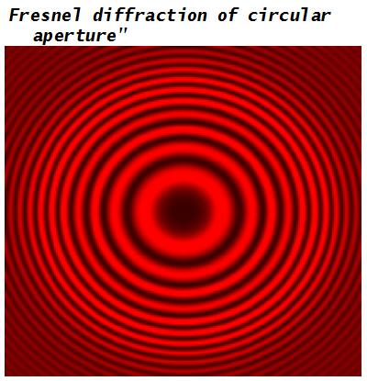
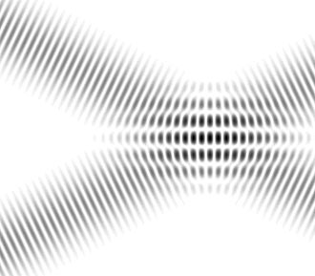
What is Optical Computing
Numbers
Real as Amplitude of Complex EMW Vector
Operations
Rough calculations of Amplitude of Random Vector to Predefined Matrix multiplication
Do all math calculations parallel with one step for all signal points
Operates with Complex EMW vectors
Rough Arithmetic Calculations
Using Interference and Diffraction of light (EMW)

Slide 4
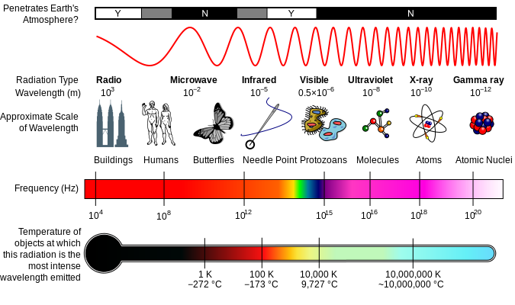
Light for Optical Computing

Slide 5

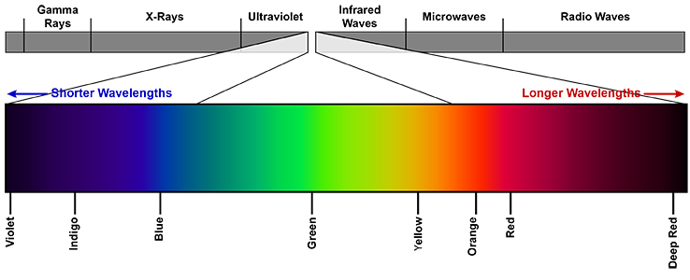
Visible Light for Optical Computing

Slide 6
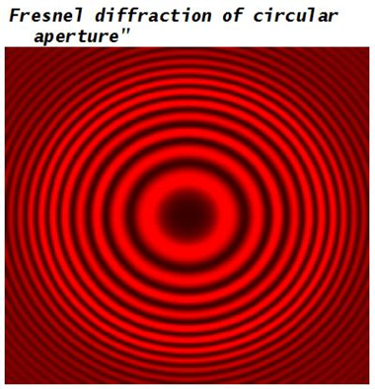
Interference and Diffraction for Optical Computing

Slide 7
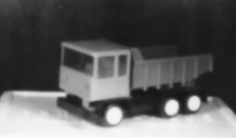
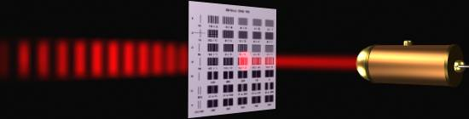
Is Experiments with Light Interference and Diffraction Need a Deep Leaning?
An answer – No.
There are sold many DIY Kids to do experiments with Light Interference and Diffraction
Laser Diode Pen Stick and printed lines and holes
Fresnel Zone Plate used as a lens

Slide 8
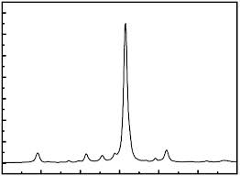
Ideal Light for Optical Computing
Monochrome
Polarized
Single Source

Slide 9
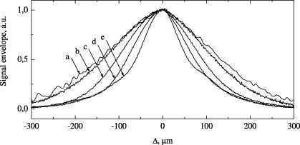
Using Real Light for Optical Computing
Using Light Sources with short spectrum range emitted and small emitted area
Lasers
Laser Diodes
Light Emitted Diodes
Using Light Detectors with short spectrum range accepted
Different Sensor Types
Using Light Filters to short spectrum range
Polarize Light by Filters
Some kind of Films
Some kind of Surface Reflections
Combination all methods above
a
b
c

Slide 10
Consumer chip market analysis results
My own research and analysis of price and characteristics of electronic components presented on consumer chip market (beginning of 2015), show that Optical Box for Optical Computing operated under control of embedded computer can be manufactured with follow properties:
Dimension of single Optical Box for Optical Computing do not exceed the dimension of modern Discrete Processor with cooling radiators.
Computing effectivity of Optical Box for Optical Computing (for special calculations) are compatible to computing effectivity of modern Discrete Processor of same size (with cooling radiators).
Manufacturing price of Optical Box for Optical Computing is chipper than manufacturing price of modern Discrete Processor and do not required so expensive equipment and buildings.
Calculation price (or energy power per single math operation) of Optical Box is 5-10% or less of Discrete Processor calculation price.
Therefore, Optical Box do not required additional cooling system like modern Discrete Processor.

Slide 11
Comparisons matrix of stock prices and energy power required
Processor Type | Xeon E5
Chips for Full HD 1920 * 1080 50Hz |  | 1 | 8
Productivity | ~200GFlops | ~1GFlops | ~512GFlops
Stock price | ~1000USD | ~150USD | ~3000USD
Energy power | ~135W | ~0.1W | ~1W
Stock price/ Productivity | ~5USD/ GFlops | ~150USD/ GFlops | ~6USD/ GFlops
Energy power / Productivity | ~0.75W/ GFlops | ~0.1W/ GFlops | ~0.2W/ GFlops

Slide 12
Trends Analysis
Analysis of trends show me that single Optical Box for Optical Computing with a size like the size of modern Discrete Processor with cooling radiators will have the bigger computing effectivity and smaller calculation price (or energy power per single math operation) then the same size Discrete Processor with cooling radiators.

Slide 13
Why Optical Computing?
Optical Computing is not a universal panacea of Computing Industry. It has many limitations, need special knowledge, and need additional research in math, optics and algorithms.
With using Optical Computing a lot of money and energy spend to simple math calculation will be saved.

Slide 14
Economics
Average computer mainframe electric bill can be 100K$/month and up.
Number of mainframes worldwide are hundreds.
Big part of money are spend to energy power for typical calculations that can be done with Optical Computing with price 90-95% or more less as usually.
Take part of money saved is a main aim for this project.
For example,
Let 100 mainframes have average electric bill can be 100K$/month
Let using Optical Computing will cut electric bill to 50%.
If 10% of saved money will be spend to Optical Computing maintenance
Then 100*100K$/month*50%*10% = 500K$/month can be spend as subscription plan for Optical Computing maintenance.
Hardware sales, third-party software licensing and consulting will generate additional money income for project.

Slide 15
Planned Cash Income Sources
Subscription Plans
Hardware Sales
Third-Party Software Licensing
Consulting

Slide 16
Applied Fields of Optical Computing
Video and Audio Processing.
Patterns Recognitions.
Trends Analysis.
Network Data Transmission.
Cryptography.
Scientific Calculations.
And more, more and more

Slide 17
Who will use Optical Computing?
Banks and Brokerages to predict stock trends.
Medical Laboratory to analyze microscope images.
3D and 2D Designers to render images of scene.
Sound Recorders to remove noise or detect voice.
Robot Designers for computer vision or AI.
And more, more and more

Slide 18
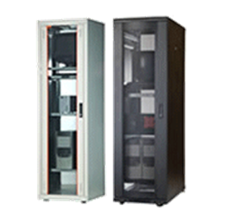
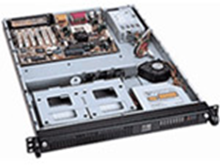
Hard & Soft
I intend to manufactory Optical Box for Optical Computing as 19’’ rack-mount case with an embedded control system and network interfaces. This manufacturing schema allow using Optical Box for Optical Computing as a Personal Device or as a Mainframe Part.
The Optical Box for Optical Computing will operate with other application and tools using web-based API (Application Program Interface) like REST, SOAP or similar. Plugins and Add-ons will be developed for the most popular applications like Adobe Photoshop, Solidworks, 3D Max, Ninjatrader, etc.

Slide 19
Roadmap
A roadmap for project required 1 year to start and include
R&D,
Market Analysis,
Negotiations,
Agreements,
Patents and Legal.

Slide 20
R&D main steps
R&D include Optical Box design and Optical Box Emulator development.
Optical Box Emulator will allow test and demonstrate functionality to customers and investors without full Optical Box manufacturing process.
Optical Box design required Component Supplier Analysis to be first.

Slide 21
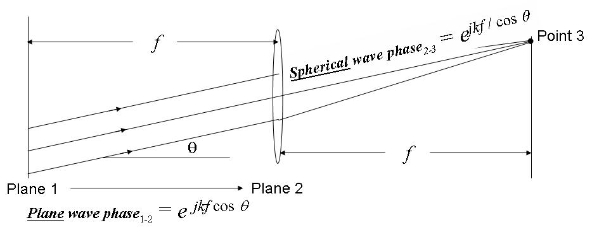
Fourier transforming property of lenses

Slide 22
Fourier Transform Usage Samples
To show how Optical Computing with 2D Fourier Transform can be used I develop some examples of image processing tools with 2D Discrete Fast Fourier Transform which is closed analogy of 2D Infinity Fourier Transform by Lens
Image Resize,
Image Blur,
Piece of Image Position Detection.
Software Packages and Tools was used for samples development
Microsoft Visual Studio 2013 C#
EmguCV/OpenCV – C++ computer vision library (bitmap data management part)
FFTWSharp/FFTW – C++ Discrete Fast Fourier Transform implementation

Slide 23
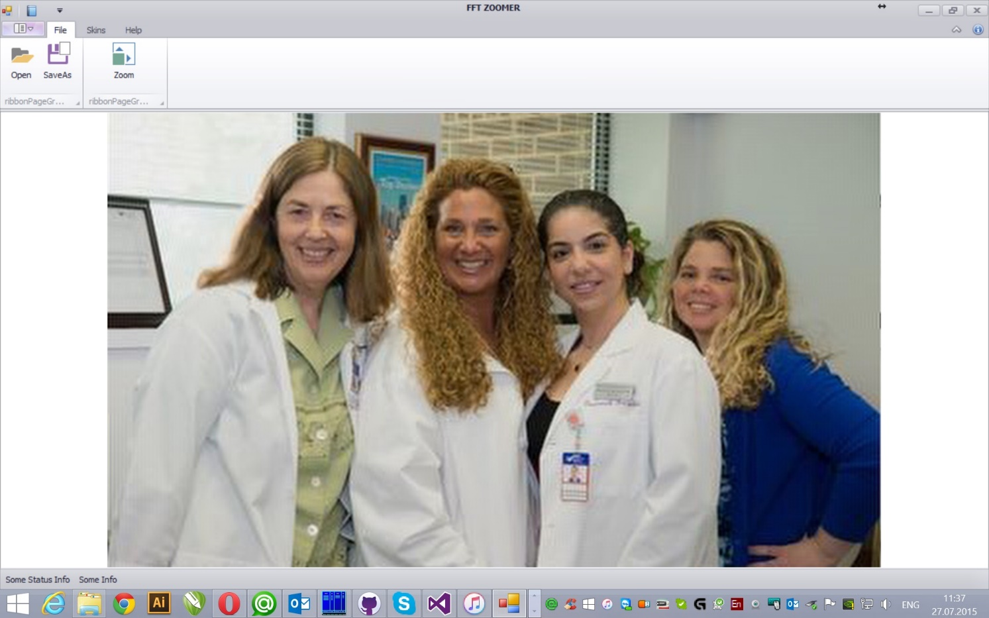
Image Resize Fourier Transform Usage Sample

Slide 24
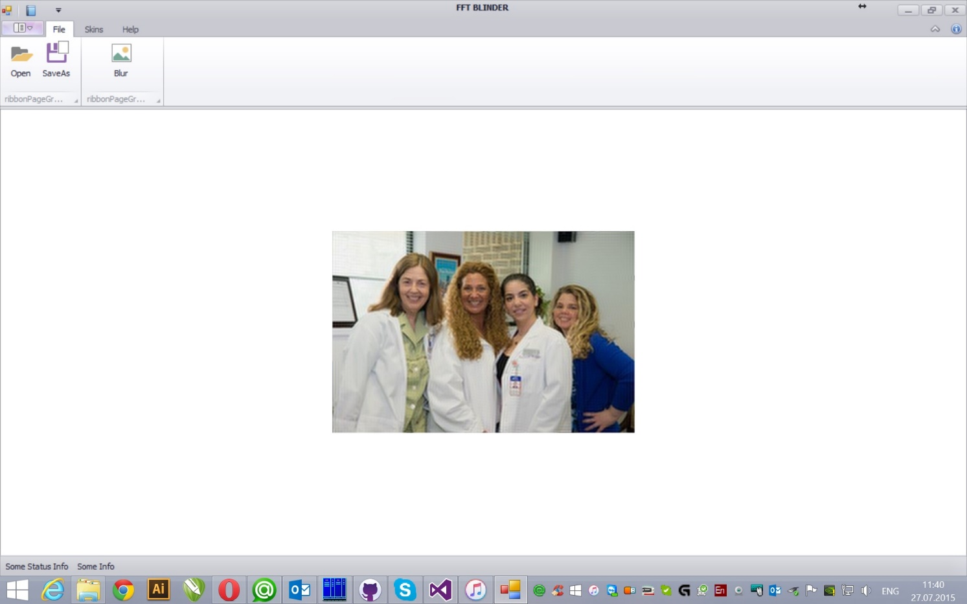
Image Blur Fourier Transform Usage Sample

Slide 25
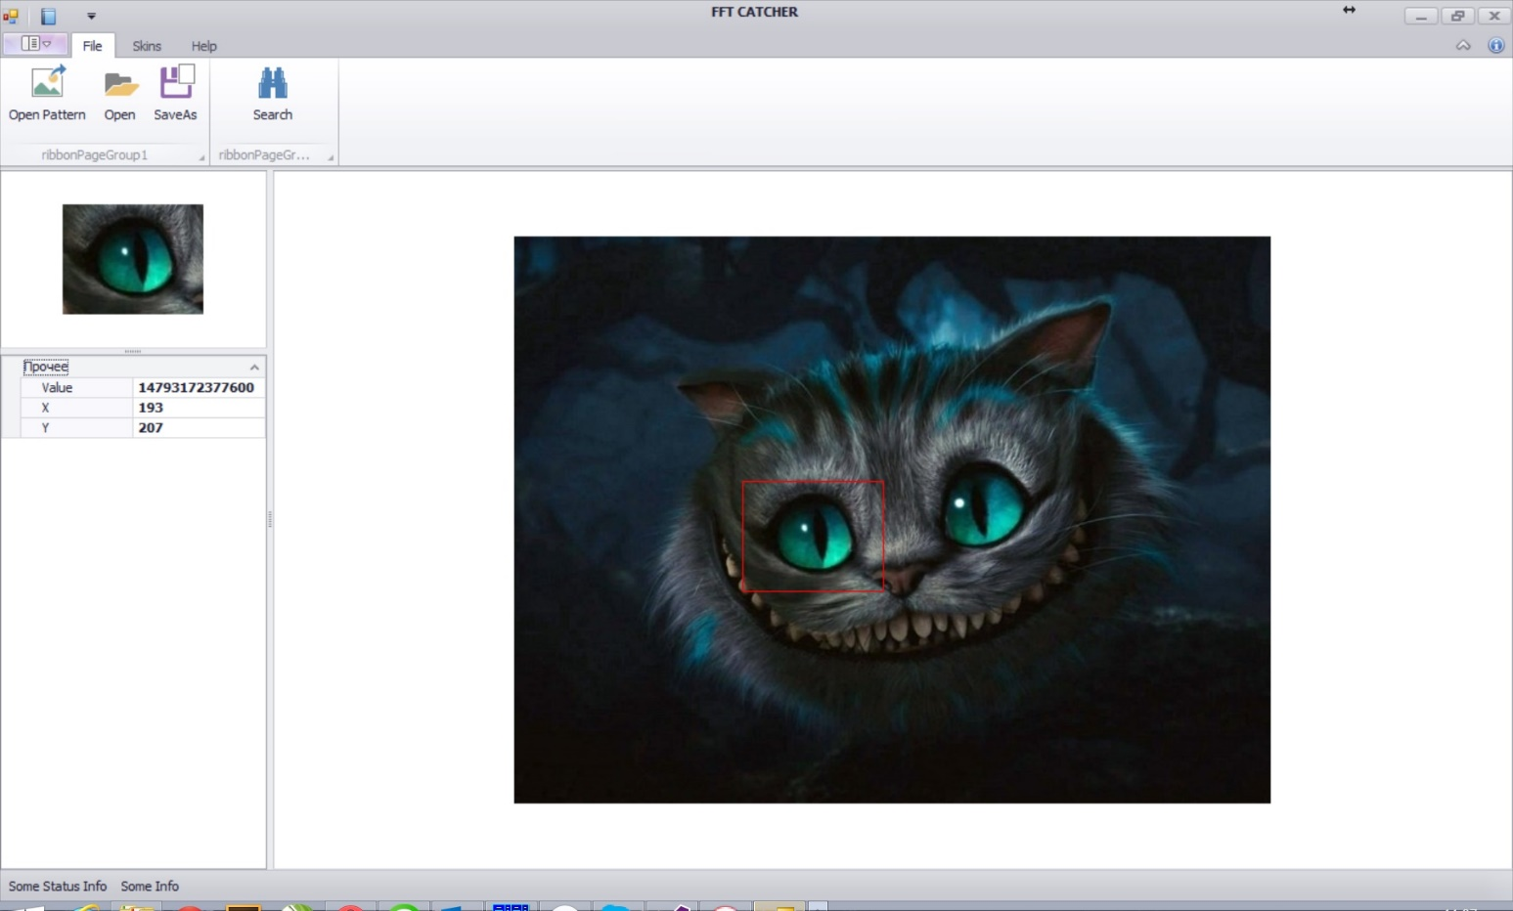
Piece of Image Position Detection Fourier Transform Usage Sample

Slide 26

Fresnel Diffraction

Slide 27


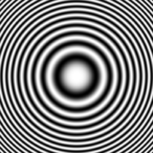
Fresnel Zone Plate Binary & Sinusoidal

Slide 28
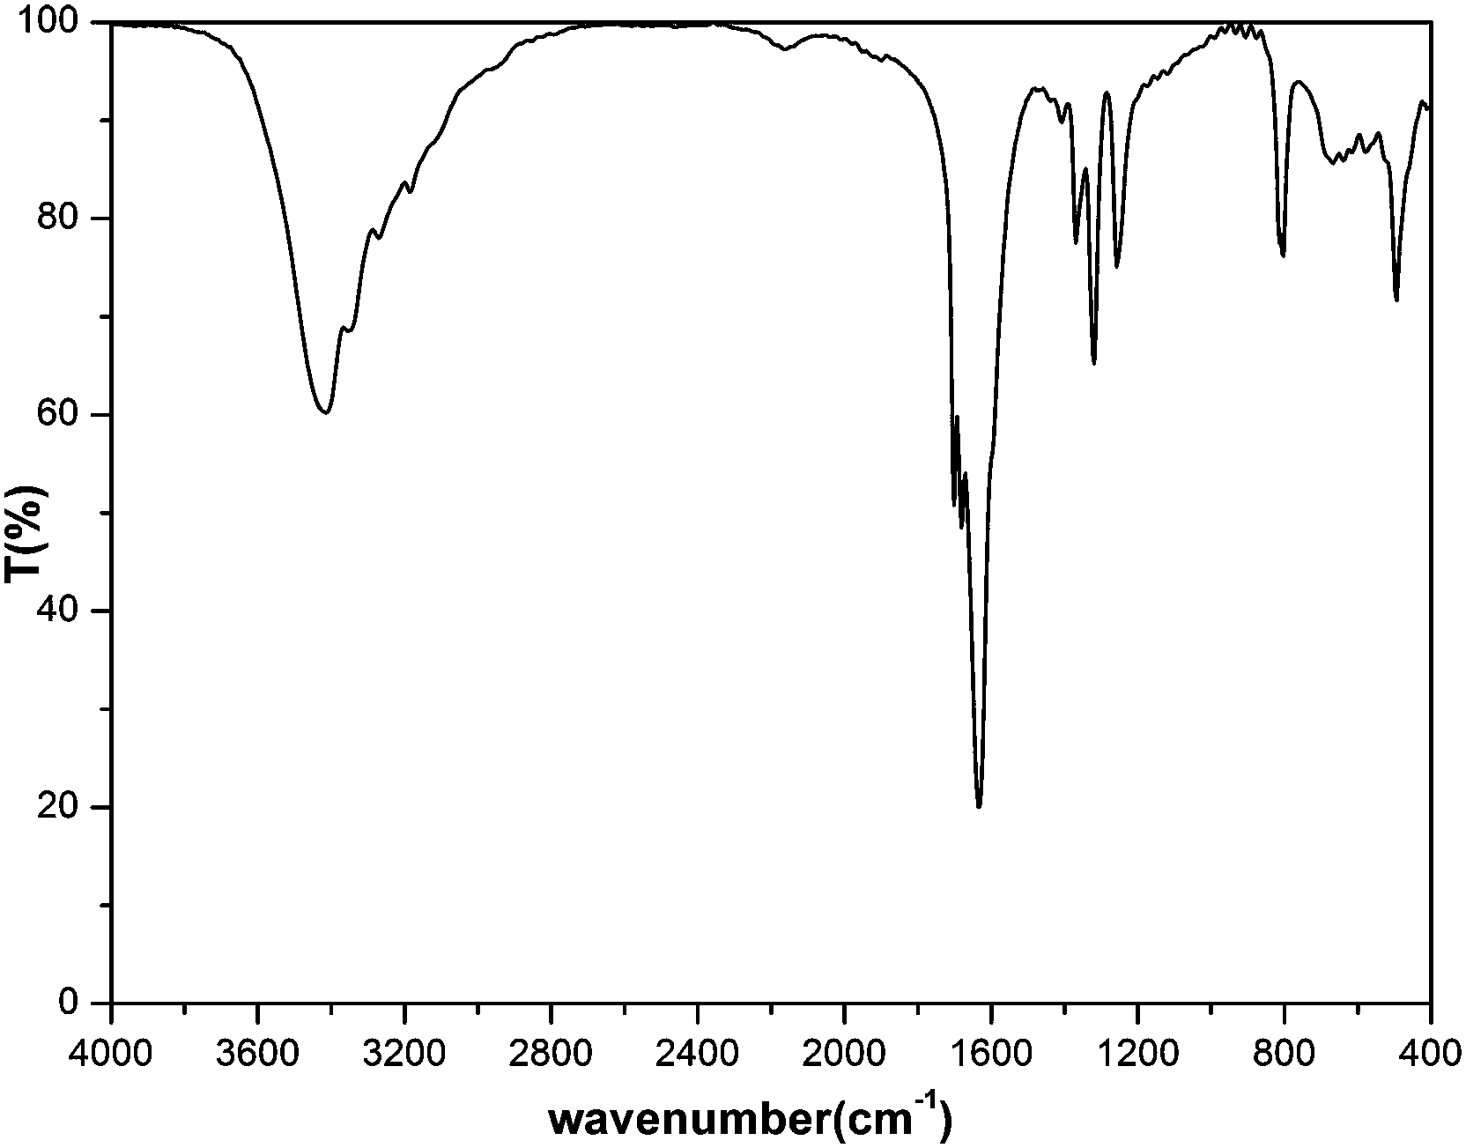
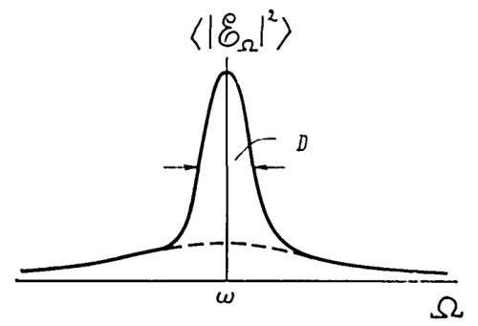
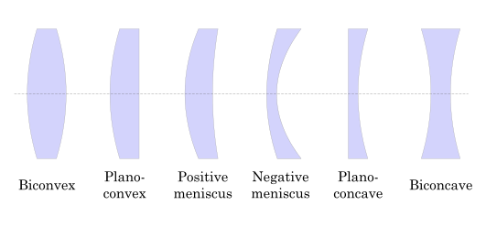
Using Zone Plate for Optical Computing

Slide 29
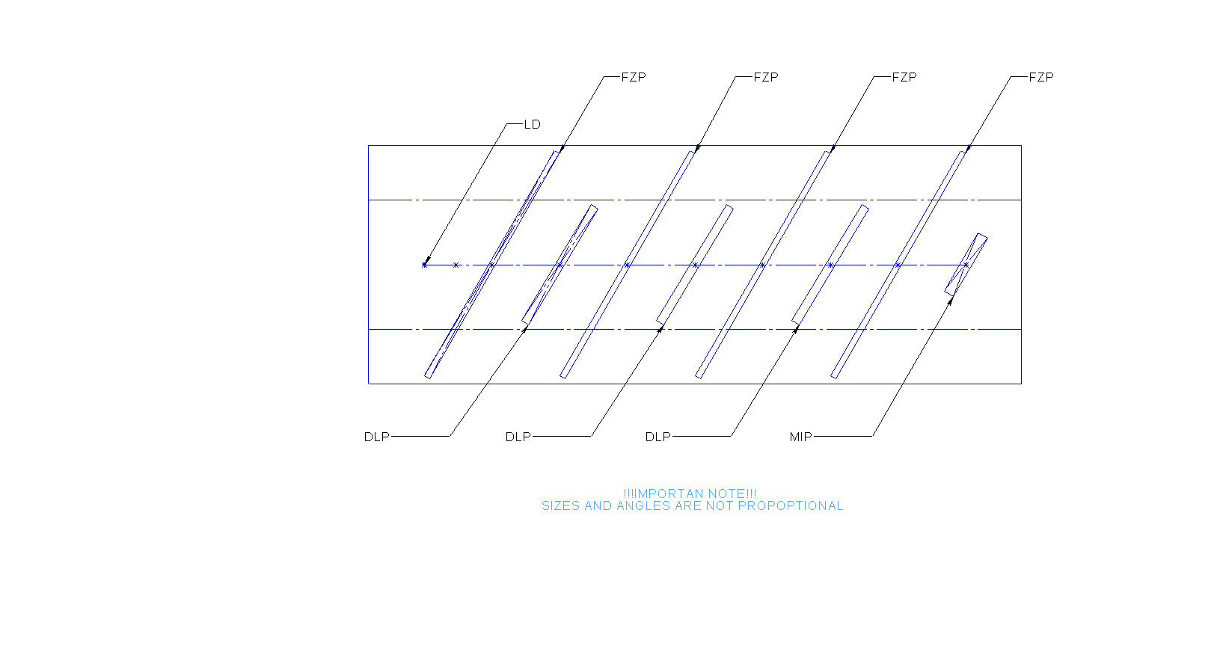
Optical Box Draft Model

Slide 30
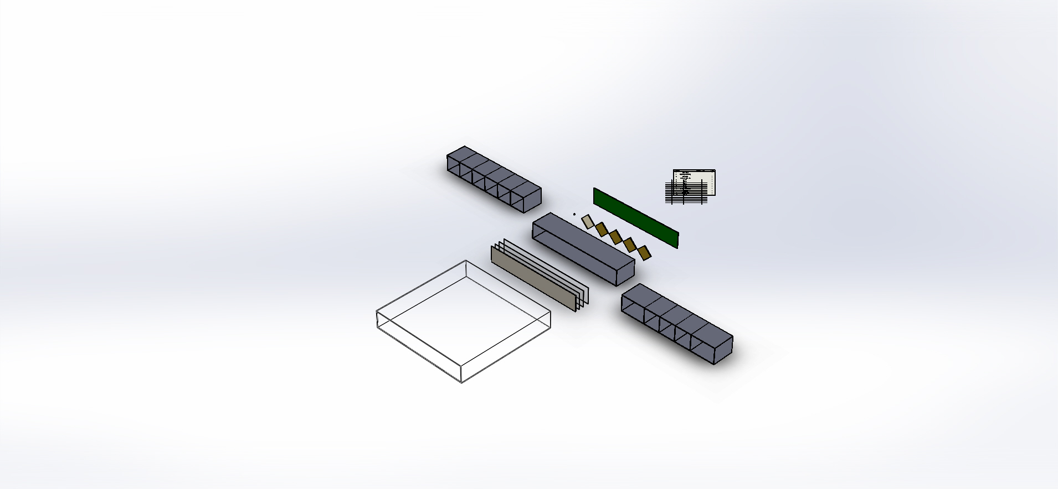
Optical Box Draft Design

Slide 31
Optical Box Design Description
Chips of LD, DLPs and MIS are mount on one side of a Circuit Board in row with equal step. LD and MIP are placed at left and right DLPs are placed in the middle.
The Circuit Board is places at one side of a Frame
At another side of the Frame placed a Film with printed FZPs, a Polarizing Filter, a Color Filter and a Mirror
Sizes of the Circuit Board, the Film with FZPs, the Polarizing Filter, the Color Filter and the Mirror are equal
A number of printed FZPs is equal a number of DLPs plus two half-sized FZPs for LD and MIS
To remove wrong light rays LD, DLPs, FZPs and MIS have collimator shutters
Light from LD multiply time pass thru FZP and reflect from Mirror on a second side of the Frame or reflect from DLP on a first side of the Frame until MIS catch a ray.
Distances between a pair of LD-FZP or FZP-DLP or FZP-MIS are equal
DLP or MIS can be combined from number of chips
Some DLP can be replaced by mirrors to reduce number of DLP chips

Slide 32
Optical Box Draft Design Description
A number of single Optical Boxes can by stacked or combined
DIPs and MISs can be placed as 1D or 2D arrays
Optical Box can be equipped by
An internal memory to fast read MIS values and write DIPs values
An embedded computer with embedded software
An Ethernet port
A front panel
A power supply
19’’ rack mount kids

Slide 33
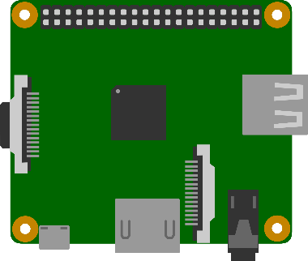

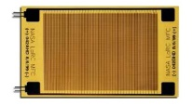

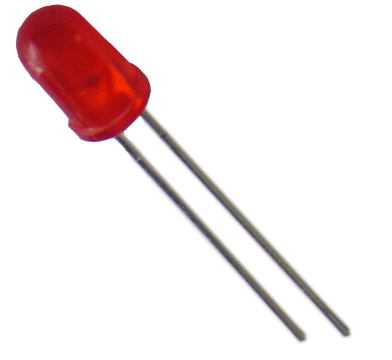
Embedded Hardware Architecture
Ethernet
Serial
HDMI
USB

Slide 34
Embedded Software Architecture
TCP/IP
Localhost
VLC
MOTION

Slide 35



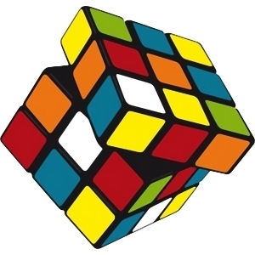
Optical Box Math Model

Slide 36
DLP Usage Notes
Usual DLP chip micro-mirrors have 3-state (3 micro-mirror reflection angle)
Parked
On or Off
Technology to generate grayed image by fast switch between On and Off states used by video projectors is not applicable by Optical Computing.
Solution Ways in case using DLP chip of micro-mirrors with limited states is
Do calculations with 1-bit numbers and apply iteration math algorithms to up precision
Use group of micro-mirrors to generate gray color
Another way to use micro-mirrors with 3-state in binary mode in case of slow MIS is
Transparent = Parked state
Opaque = fast random switch between On and Off states.
fast random switch between two states will generate average energy picture caused random diffraction pictures cached by MIS

Slide 37
Optical Box Math
Optical Box Design do parallel math calculations of signals on DLP
Optical Box Design do not calculate Fourier transforming
Optical Box Design do calculate Some (Unknown, depended from device implementation) Matrix Multiplication transforming of signals on each FZP
Because Optical Box Design has more then two DLP
Reverse of Unknown Matrix
Can be calculated by experiments (during Optical Box Calibration)
Can be saved for future use in embedded memory of Optical Box
Can be used for calculation needed
One DLP (if light is high polarized) or two DLP (if light is low polarized) can be used to correct total matrix production for calculation needed like Fourier transforming, Walsh-Hadamar transforming and etc.

Slide 38
Optical Box Calibration Definition
If Y = OUTPUT(X1,X2,X3,…) is an output from Optical Box with X1, X2, X3 … values of DLPs
If F(X1,…,Xn-1) = max || OUTPUT(X1,…,Xn-1,X) - | X*M | || for all X
If F(C1,…,Cn-1 ) = min F(X1,…,Xn-1) for all X1,…,Xn-1
Then values C1,…,Cn-1 will be named Calibration for transformation matrix M and
Y=| X*M | = OUTPUT(C1,…,Cn-1,X)
Calculations can be done with PC and Optical Box together or within Optical Box only using embedded discrete computer

Slide 39
Minimal Optical Box Calibration Size
Calibration allow to remove non-linear distortion due non-ideal conditions of single lens transformation.
The main distortion for Interference and Diffraction of light caused by Non-Polarized light. Some materials can change light polarization during light reflection or pass thru transparent material.
EMW consists of Electric and Magnetic Parts
If light is Non-Polarized Electric(or Magnetic) Parts of two beams are not summarize as values but summarize as direct vectors so light detector catch average power for all cells and do not recognize Interference/Diffraction picture of two beams of light.
Electric and Magnetic Parts of any EMW can be present as complex number or as a pair of real numbers
Calibration which can remove distortion caused by Non-Polarized light must contains a pair of real calibration values for any output amplitude value at point as real number.

Slide 40
Optical Box Calculations Precision
Fact
Calculation with using optics calculations gives rough results
Solution Ways
Same algorithms like sorting, brute force, branch-and-bounds and etc. do not need precision for all results but selected only. Selected results can by calculated traditional way or improved by additional math iteration algorithms of selected results.
There are many step-by-step math iteration algorithms exists to up precision as needed
Conclusion
Rough results can by used effectively

Slide 41
Optic Box Tools Developed
Optic Box Tools
FZP Builder
Software Packages and Tools was used for samples development
Microsoft Visual Studio 2013 C#
EmguCV/OpenCV – C++ computer vision library (bitmap data management part)
FFTWSharp/FFTW – C++ Discrete Fast Fourier Transform implementation

Slide 42
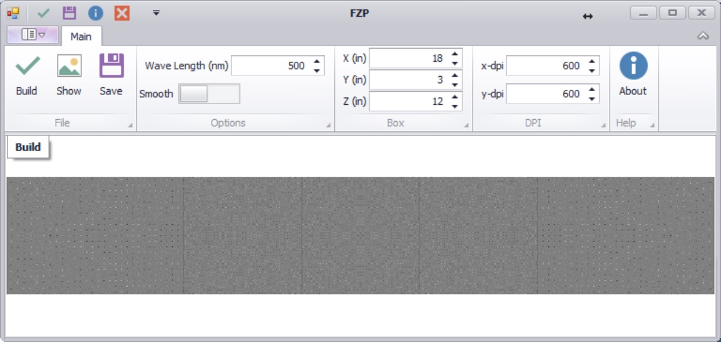
FZP Builder Optic Box Tools Developed

Slide 43
Thank You
Contacts
Dmitry Protopopov, Moscow, Russia dmitry@protopopov.ru +7 916 6969591
Taras Kovtun, Boca Raton, FL, USA boss@rbadesign.us

